Slide 1
THE
PROTESTANT
REFORMATION

Slide 2
Happy 2nd Day of Second term!
Log # 3
What are some things that need to be reformed in our society (identify at least 3).
Thank you!

Slide 3
Tuesday, November 5
Background to the Reformation
Underlying Causes of the Reformation
Introducing…..Martin Luther!

Slide 4
Protestant Reformation
Words within words

Slide 5
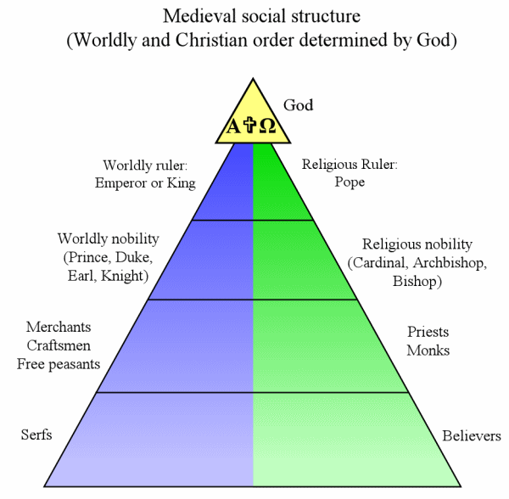
Tenets of the Roman Catholic Church
Hierarchy

Slide 6
The RCC
Transubstantiation
Indulgences
Worship of Saints
Sources of authority: Bible and High Church Officials
Purgatory
Clerical celibacy
Monasticism

Slide 7
The RCC
7 Sacraments
Baptism,
Confirmation,
Holy Communion, Confession,
Marriage,
Holy Orders,
and the Anointing of the Sick

Slide 8
Prior to the 1500s…
The Catholic Church as a powerful social, religious and political institution
How would the following weaken the status of the RCC?
Babylonian Captivity (pages 355 and 408), the Great Schism (Bass), John Wyclif (356), Marsiglio of Padua (355-356), Jan Hus (356, 357, 427), Conciliar Movement (page 356)
(Great Schism vid)

Slide 9
The Brothers of the Common Life
A lay religious movement in Northern Europe on the eve of the Reformation
It fostered a religious life outside of the formal church offices and vows
This life would be filled with prayer and study without surrendering to the secular world
Laity and Clergy shared this common life, stressing individual piety and practical religion
The Bible, scripture, was stressed as the true authority
The members were educators, publishers, and doctors
In particular they sponsored schools for young men who wanted to enter the Priesthood
One of their prize pupils was Erasmus “The proclaimed prince of the humanist”
Erasmus later infused his own Philosophy of Christ with what he learned from the Brothers of the Common Life

Slide 10
Thomas a Kempis (Imitation of Christ)
This work was written initially as a guide to the inner life for Nuns and Monks
The book however became widely read by the laity who wanted to pursue a more Christ like life
The book was a source of Northern European Humanism and Protestantism
The book brought about the idea of individualistic religion
The book was hostile to the idea of church and papal authority.
The book was published in the vernacular at a time when the laity was looking for new ideas

Slide 11
Good Morning!
Using the information in the document that is on your desk, please write an underlying cause of the Reformation on the back of the document.
Thank you!

Slide 12
Thursday, November 7
Underlying causes of the Reformation
Docs. , role plays, HH clip, and other power point
Quick Review
Circle Up!
COR
Intro. To Luther
Act it out!
Video
Protestant vs. Catholic thought/beliefs
Columns
Other Protestant reformers

Slide 13
Make connections between things you have learned about the Reformation thus far and this image.

Slide 14
Problems within the Church in the 16th Century
Role Plays
Papal Behavior
http://www.youtube.com/watch?v=GfpRk9FOFeg
Pope Alexander VI

Slide 15
Happy Monday!
Log # 4
If you were Pope Leo X (Pope when Martin Luther posted his 95 Theses on a church door in Wittenberg, Germany), how would you respond to Martin Luther’s complaints about indulgences and other church conduct?
Defend your response.
Thanks!

Slide 16
Monday, November 11
Quick Review
Grade COR
Finish Luther Role Play
Clip and how Leo X responded
(6:33)
Frederick (15:00)
Warning (19:00)
Revolution and Sacraments (22:30)
Papal Bull (26:00)
(27:47) Diet of Worms
End oF SPEECH (34:00)
Protestants vs. Catholic Chart
A little predestination OL
Additional information about Calvin
Index Review
Line up
Matrix
Add Anabaptists
Charles V and the HRE
Family Tree
Maps
Info.
The Reformation in England
First to 3 with Henry VII
http://www.youtube.com/watch?v=PCmogoGpnxg (Tudor overview song)
Lifesizers
Notes:
http://video.pbs.org/video/1379563195/

Slide 17
Happy Wednesday!
Working with your teammates, discuss two similarities and two differences between Protestantism and Catholicism.
You don’t need to write anything down (yet).
Thank you!

Slide 18
Wednesday, November 13
Protestants vs. Catholic Chart
Index Review and COR
Line up
Matrix
Add Anabaptists
Charles V and the HRE (slide 27)
Family Tree
Maps
Info.
The Reformation in England
First to 3 with Henry VIII
http://www.youtube.com/watch?v=PCmogoGpnxg (Tudor overview song)
Group timeline
Baroque art
Handel’s Messiah
http://www.youtube.com/watch?v=usfiAsWR4qU
Rubens and Intro (minute 1:17)
http://www.youtube.com/watch?v=zZ1o_WMcGik
Guest on Thursday
German Peasants’ Revolt
Docs and analysis

Slide 19
Index Homework
John Calvin
Ulrich Zwingli
John Knox
Pope Leo X
Johann Tetzel
Charles V
Colloquy of Marburg
German Peasants’ War of 1525
Peace of Augsburg

Slide 20
#1 Which of the following would most likely allow women to preach and spread the message of the Reformation?
A. Lutherans
B. Calvinists
C. Anabaptists
D. Zwinglians
E. Anglicans

Slide 21
#2 Which of the following best described Henry VIII’s motives for his break with Rome?
A. He wishes to control the church but leave doctrine untouched.
B. He had been deeply influenced by Lutheran theology.
C. Thomas More convinced Henry of the advantages of such a break.
D. He needed the support of the nobility, many of whom were Protestant.
E. His aggressive foreign policy in Italy led to his excommunication.

Slide 22
#3 All of the following are characteristics of Baroque art and architecture EXCEPT:
A. direct naturalism, sometimes violent
B. high emotional intensity and dynamic movement
C. glorification of kings and religious belief
D. Adherence to the rules of scientific perspective
E. Colors were brighter than bright and dark was darker than dark.

Slide 23
#4 Which religion was eventually adopted by the states of Denmark, Sweden, and Norway (16th Century)?
A. Presbyterian
B. Catholicism
C. Calvinism
D. Lutheranism
E. Anabaptism

Slide 24
#5 Which eastern European state was ruled jointly by Ottoman Turks, Habsburgs, and an ally of the Ottomans in the 16th Century?
A. Poland
B. Bohemia
C. Hungary
D. Lithuania
E. Ukraine

Slide 25
Roundtable of Protestants (Zwingli, Calvin, Knox)
What would you think about:
Indulgences
Predestination
Church authority
Separation of church and state
Monasticism and celibacy
Head of the Church
Authority
sacrament

Slide 26
Additional Causes
See other power point

Slide 27
Happy Friday!
Please take a piece of blue cornell from the team folder.
For the topic, please write “Catholic or Counter Reformation.”
Thank you!

Slide 28
Our Guest
History Professor at BYU for over 40 years
Jessica Tobler’s grandfather
Last year
Questions throughout the presentation
Detailed notes and summaries

Slide 29
Homework for Monday
French Religious Wars (pages 433-434)
Kash, Matthew, Paige, and Madison L.
Conflict in the Netherlands (pages 434-435)
Anna, Madison G., Russell, Seaton, Cody
Witch Hunts (pages 435-437)
Rachel, David, Baylee, Kade
30 Years’ War (pages 482-484)
Ian, Connrey, Karissa, Mason, Andrew

Slide 30
Homework for Tuesday
French Religious Wars (pages 433-434)
TJ, Salma, Emmalee, Andres and Faith
Conflict in the Netherlands (pages 434-435)
Kage, Kelsey, Allison, Weston and Hudson
Witch Hunts (pages 435-437)
Aspen, Seth, Esmeralda, Xandi and Ashley
30 Years’ War (pages 482-484)
McKenna, Jonathon, Dayton, Maurissa, and Adrina

Slide 31
Happy Thursday!
Log # 5
Please turn to page 429 in your textbook.
What are three conclusions that can be drawn from the map of Europe ca. 1555?

Slide 32
Thursday, November 14
Charles V and the HRE (slide 28)
Family Tree
Maps
Info.
The Reformation in England
First to 4 with Henry VIII
http://www.youtube.com/watch?v=PCmogoGpnxg (Tudor overview song)
Group timeline
Baroque art
Handel’s Messiah
http://www.youtube.com/watch?v=usfiAsWR4qU
Rubens and Intro (minute 1:17)
http://www.youtube.com/watch?v=zZ1o_WMcGik
German Peasants’ Revolt
Docs and analysis
The Counter Reformation
Sell your response!
Index of Prohibited Books
Jesuits and other orders
The Council of Trent
Notes:
http://www.historyteacher.net/EuroCiv/Weblinks/Weblinks-5-TheReformations.htm (debate Counter Reformation)

Slide 33
Charles V 1500-1558
He ruled over extensive domains in Central, Western, and Southern Europe; and the Spanish colonies in the Americas and Asia
Raised in the Netherlands
Charles was born and raised in the Netherlands, but spent most of his time as a monarch in Spain, leaving his German provinces to be governed by Hapsburg cousins
"Plus Ultra", "Even Further"
Staunch Catholic
40 Year Reign
Notes:
http://en.wikipedia.org/wiki/Charles_V,_Holy_Roman_Emperor
http://www.heritage-history.com/www/heritage.php?Dir=characters&FileName=charles5s.php

Slide 34
Charles V
Age of Exploration and colonies
Reformation
Ottoman Turks encroaching on Southeastern Europe
Most significant enemies, from his point of view, were Catholic France and the Moslem Turks.

Slide 35
Charles V
Why would he allow limited Protestant practice in the Holy Roman Empire?
Why would the spread of Protestantism be a threat to him politically?
Imperial army sacked Rome in 1527 and drove the Pope into exile because he allied himself with Charles' enemy Francis I.

Slide 36
Charles V
Reinstated power of the nobles in Spain
Wealthy Spain during his reign…but the beginning of the end (gold and silver from the New World to fight his wars)

Slide 37
Charles V
Retired to a monastery in 1556
Died in 1558

Slide 38
Timeline—Tudor Monarchs
Henry VIII
Edward VI
Mary (bloody)
Elizabeth
Dates of Reign
Accomplishments
Misguided Actions
Stance and Action taken on Religious issues

Slide 39
COR
Butcher Paper Add Ons
Protestant Views on Marriage and Sexuality
The Christian Church in the Early 16th Century
Martin Luther
Protestant Thought
Appeal of Protestant Ideas
The Radical Reformation and German Peasants’ War
Image (next slide)

Slide 40
Make connections between what you read and this image

Slide 41
Martin Luther
The man, the myth, the legend!
http://video.pbs.org/video/1379563195/
5 things learned every 10 minutes

Slide 42
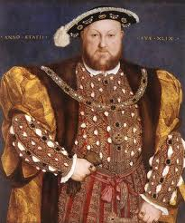
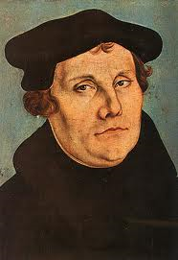
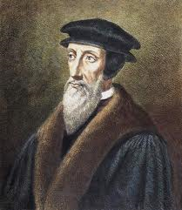
THEMES
Irrevocable split in the RCC b/w Catholic and Lutheran
Eventually Protestants split into many different sects
Three flavors:
Protestant Reformation
English Reformation
Counter/Catholic Reformation

Slide 43
OBJECTIVES
What late medieval religious developments paved the way for the adoption and spread of Protestantism?
Why did the strictly theological ideas of Martin Luther trigger political, social, and economic reactions?
What were the consequences of the schism?
Do the various reform movements represent revolution or continuity?

Slide 44
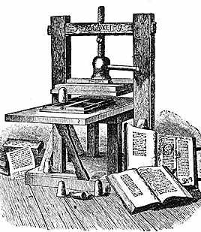
CAUSES
Political – power struggle, resentment over Church’s claim over civil authority
Economic – Church’s wealth and properties, tithe (church tax), resentment of $ flow to Rome
Intellectual – Renaissance ideas – questioning attitude – doubt religious power and authority
Technological – Printing Press

Slide 46
CAUSES
Worldliness – luxurious and materialistic lifestyles of popes and high clergy
Nepotism – appointing relatives to Church positions to the Church regardless of ability
Simony – buying and selling of Church positions
Indulgences – accepting $ for Church pardons

Slide 47
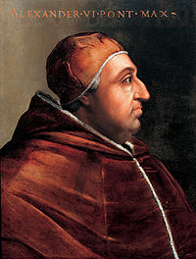
CAUSES
Clerical pluralism – holding more than one office
Clerical ignorance – many priests were illiterate
Clerical immorality – gambling, drinking, concubines of women
POPE ALEXANDER VI (1492-1503)

Slide 48
DECLINE IN PAPAL PRESTIGE
Babylonian Captivity (1309-1377) – Popes lived in Avignon under French Kings
Great Schism (1378-1417) – struggle for Church Supremacy – rival popes Avignon and Rome claim to be the true Pope (3 Popes??? Authority???)
Conciliar Movement – periodic councils, assemblies to reform the Church

Slide 49
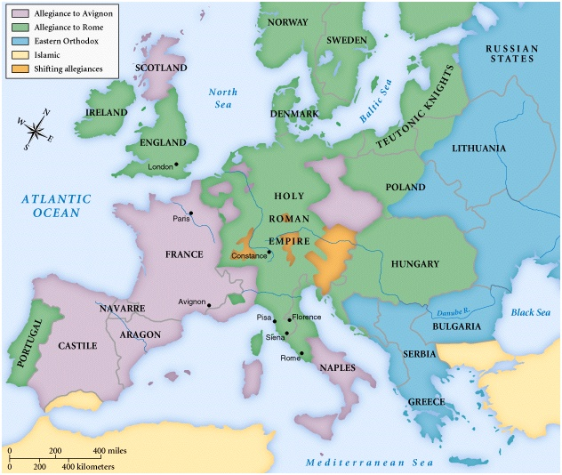
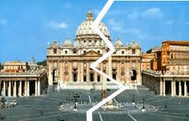

Slide 50
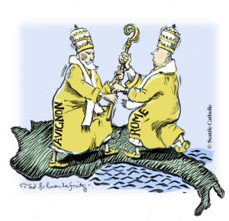
CONCIL OF CONSTANCE
1414- 1418
Three objectives
END SCHISM
WIPE OF HERESY
ELECT A NEW POPE
MARTIN V (1417-1431)

Slide 51
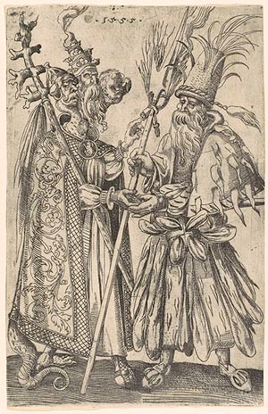
Satire on Popery
1555

Slide 52
POWER OF THE RCC
Middle Ages (500-1500) – civilizing agent
Missionaries – converted the pagan population
Hospitals – care for the sick
Cathedrals and Monasteries – centers for learning
Pope Leo III crowned Charlemagne 800 C.E. – foundations of the HRE
Papal States – Pepin the Short (714?-68) granted land to the Pope

Slide 53
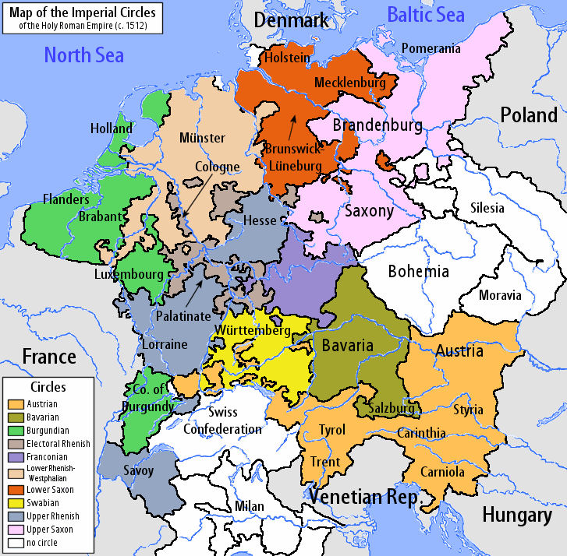
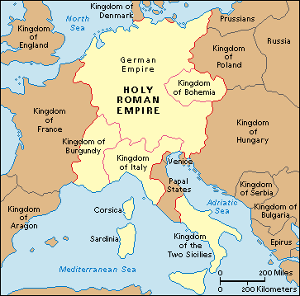
HOLY ROMAN EMPIRE
HRE – “The HRE was neither Holy, nor Roman, nor an Empire” – Voltaire
Originally Charlemagne “Emperor of the Romans”
Loose confederation of 300+ States
Holy Roman Emperor elected by 7 Elector States
Hapsburg Family – Austria – Powerful (1440-1806)

Slide 54
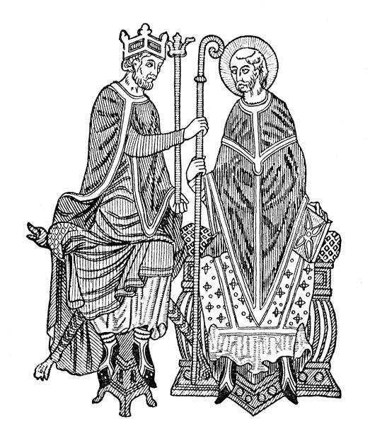
CHALLENGES TO POWER
Investiture Controversy – power struggle kings and popes during the Middle Ages
1075 Pope Gregory VII – only the Pope could name Bishops
German King Henry IV challenged the decree claiming Kings had the right to name Bishops
King Henry IV excommunicated – eventually back down

Slide 55
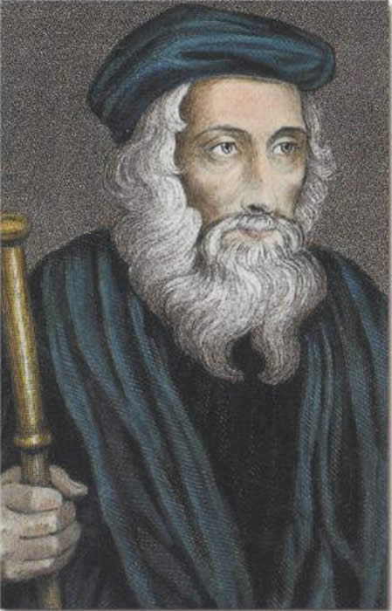
LUTHER’S PREDECCSORS
John Wycliffe (1328?-1384) – English Priest
Condemned the wealth and worldliness of the RCC
Bible highest religious authority
Translated the Bible into English
Denounced by the Pope – followers Lollards harshly persecuted

Slide 56
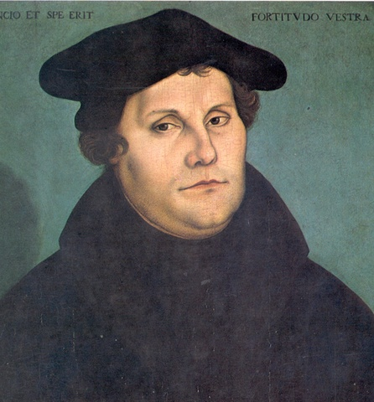
MARTIN LUTHER
Martin Luther
Great Man?
OR
Man of His Times?

Slide 57
WHY WAS LUTHER SUCCESSFUL?
Social
Political
Religious
Intellectual
Technology
Economic

Slide 58
REFORMATION THEOLOGY
Reformo – latin “to form again, mold anew, or revive”
“Scripture alone” – Bible sole authority, salvation cannot be bought and sold
“Faith alone” – Salvation through God’s grace not good works
“Christ alone” – No other mediator b/w God and humanity, rejects the hierarchy of the RCC
“Glory of God alone” – vocation
Bible translated into Vernacular (Luther’s German Bible)

Slide 59
CONSEQUENCES
End of a united Christendom
Brutal, bloody wars of religion, religious persecution
Religious, Social, Political conflicts intermingled
Emphasis on education – establishment of modern languages (German, English) not Latin
Confiscation of Church lands increased power for rulers
New emphasis place on family and marriage

Slide 60
CONSEQUENCES
Counter Reformation – RCC reaffirmation of traditional Catholic theology
Growth of Capitalism – material success a sign of Grace, moral discipline, and individualism
Italy, Spain, Austria, Hungary, Poland, S. Germany (Catholic)
N. Germany, Baltic region (Lutheran)
Scotland, Switzerland, Holland (Calvinist)
England (Anglican)

Slide 61
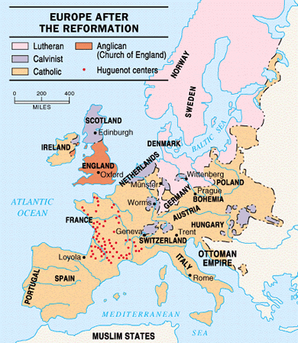

Slide 62
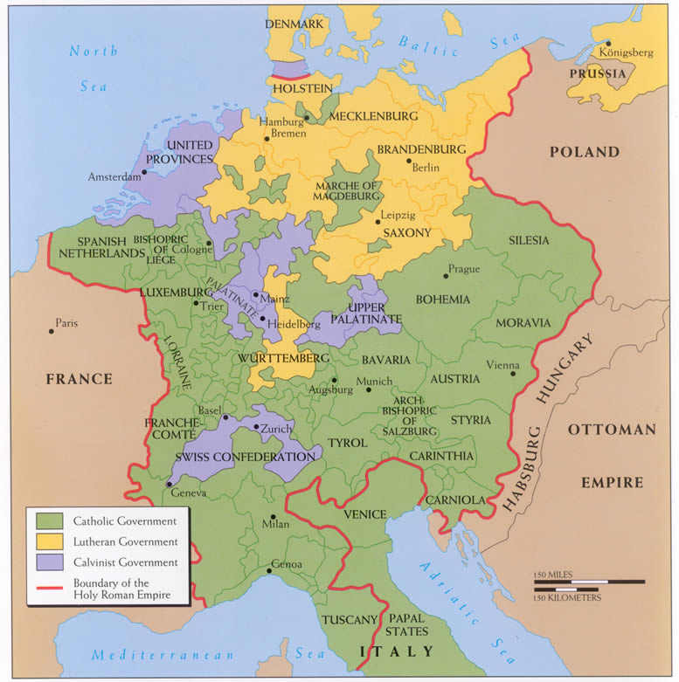

Slide 64
CONSEQUENCES
DID LUTHER SAVE OR DESTROY THE RCC?

