Slide 1
Top ten

Slide 2
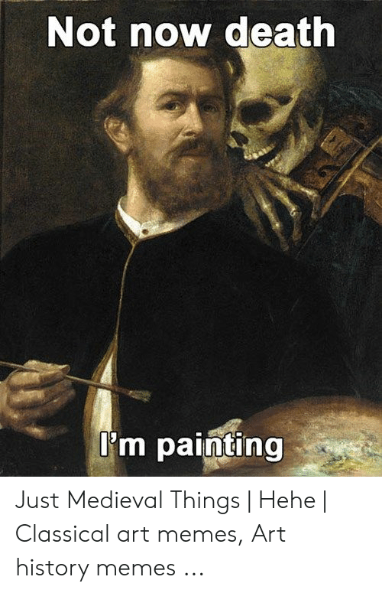
Make a list of the top ten things that have happened in European history from the middle ages through 1648; be prepared to defend your choices

