Slide 1
Renaissance humanists tweet your hearts out!

Slide 2
Name of your humanist
Team Names:

Slide 3
Your historical figure’s username
(fitting for your person)
Example: Machiavelli’s username=@fear this!

Slide 4
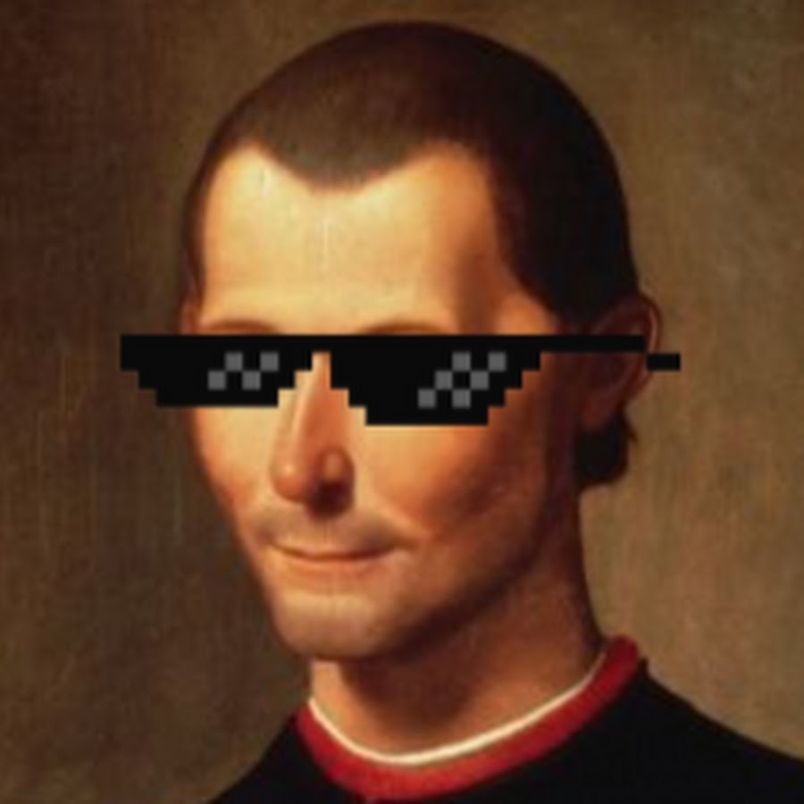
Short bio
Niccolo Machiavelli was a statesman and political theorist who served as an ambassador for the city state of Florence for 14 years when the de medici were out of power. When he resisted the de medici’s return, Machiavelli was tortured and thrown in prison. He wrote one of the most influential political handbooks in history. He wanted a united Italy under a strong, centralized ruler. He encouraged rulers to stay in power through methods that might seem immoral. He wanted a separation of morality and politics. He encouraged leaders to be both feared and loved. If they had to choose one, however, he claimed that fear is best. His words have been used by historical figures to justify their cruel and cunning leadership styles. To be Machiavellian implies ruling through ruthless means.

Slide 5
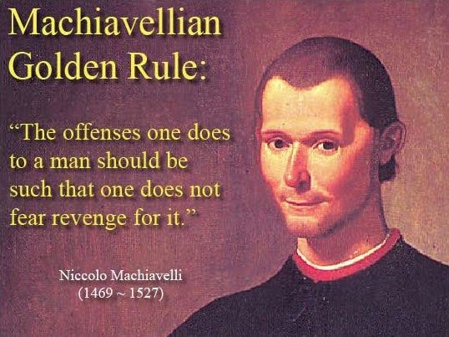
10 Tweets related to what you wrote; your ideas on human nature; whether you were a Christian or civic humanist; and anything else that is notable about you
wrote The Prince, stay in power fool; ends justify means; #Cesare Borgia is boss!
Humans are nasty! Think of people in department stores during the holidays; #Cynics rule!
civic humanists disarm Christian humanists # takedown!
Prison brought out the worst in me-man, I hate the de medici!

Slide 6

Most men are “ungrateful, fickle, dissembling, anxious to fear danger, and covetous of gain.” only losers worry about morality!
Pope Clement VIII condemned my book THE Prince for its endorsement of rule by deceit and fear-dumb! LIGHTEN UP, POPEY!
“Since love and fear can hardly exist together, if we must choose between them, it is far safer to be feared than loved.“

Slide 7
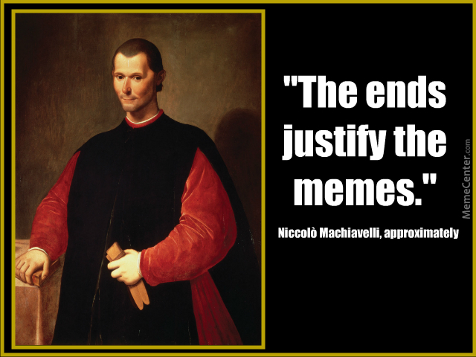
#THE ART OF WAR MUST BE STUDIED; FAIL AT THIS, AND YOU FAIL AS A LEADER.
Cruelty + kindness=a winning combo!
Employee of the month-you bet! Reward those in your state who do “good things.”
As a leader, you should be a lion and a fox. Tough and strong, you got this!

Slide 8
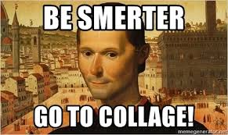
Followers
Ms. Bass
Lynsi Snyder
Elizabeth I
Thomas hobbes
Cesare Borgia
Putin

