Slide 1
Northern renaissance art
Group Member Names:

Slide 2
Characteristics of northern renaissance art (at least five):

Slide 3
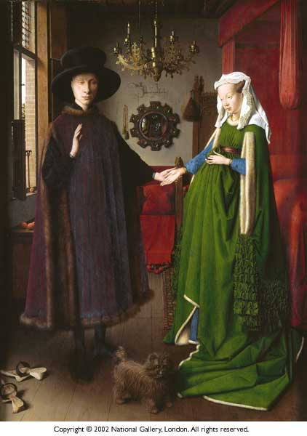
Research and type 5 facts about the Arnolfini wedding (including the name of the artist):

Slide 4
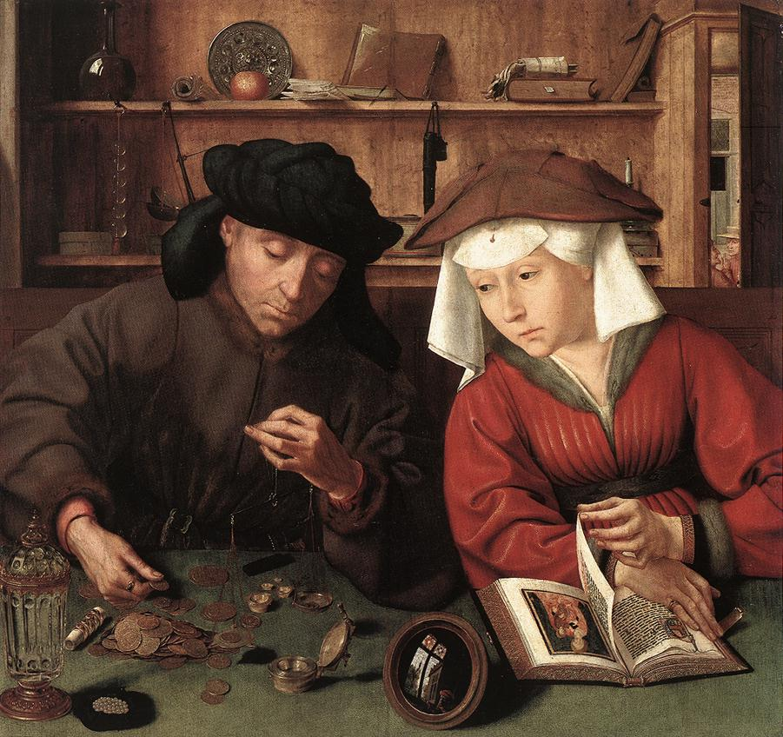
Massys’ The Moneylender & His Wife, 1514
5 facts about this painting and the symbolism within the painting

Slide 5
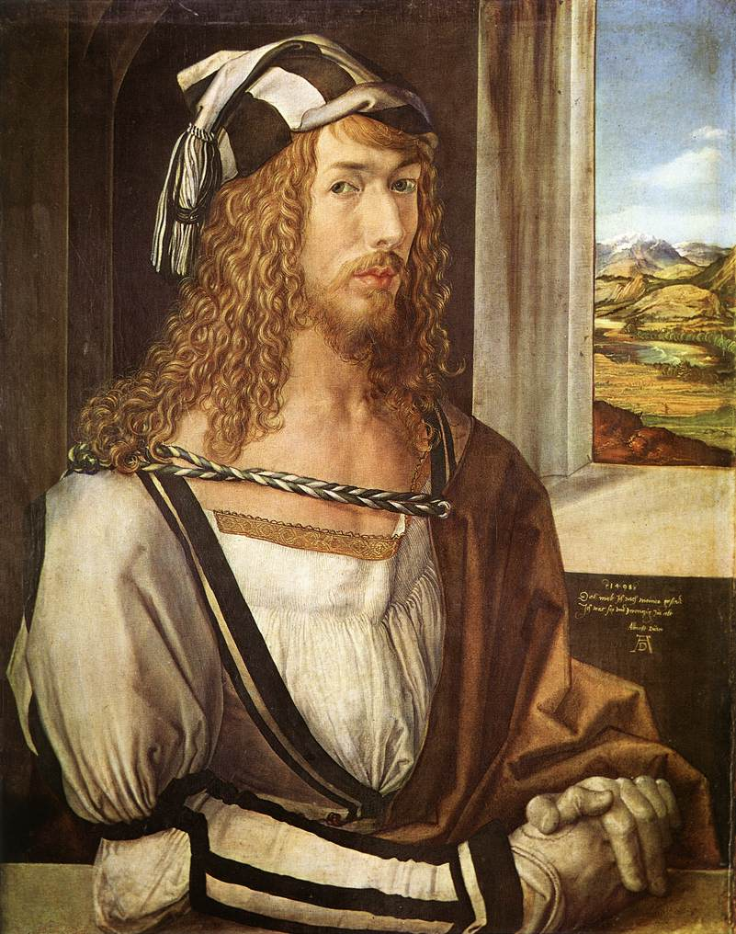
Albrecht Dürer (1471-1528)
5 Interesting facts about this artist:

Slide 6
Find an image for durer’s “Four horsemen of the apocalypse,” and write five facts about the painting + its meaning (image on the right; info on the left)

Slide 7
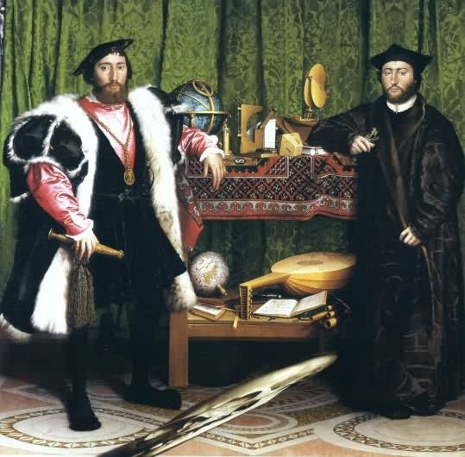
Holbein’s, The Ambassadors, 1533
A Skull

Slide 8
Research Holbein’s “the ambassadors” and type five things that you learn about it below:

Slide 9
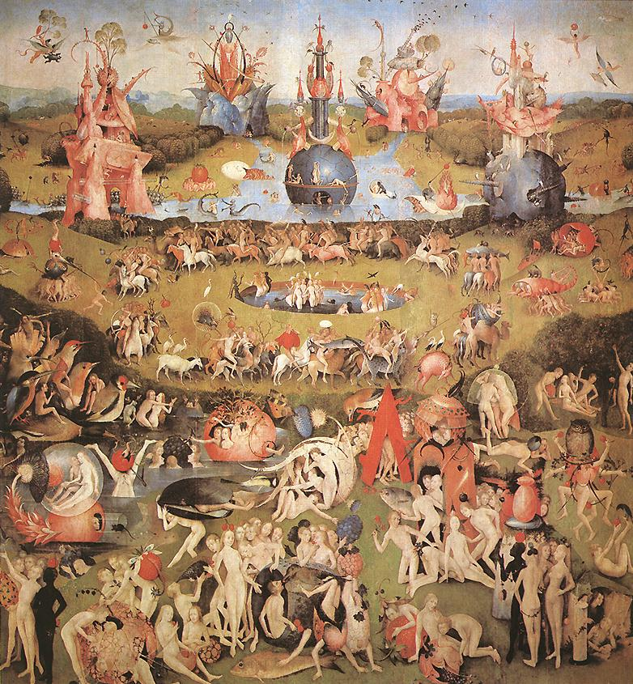
Hieronymus Bosch The Garden of Earthy Delights 1500

Slide 10
Research bosch’s “The Garden of Earthy Delights” and type five things that you learn about it below:

Slide 11
Research and find characteristics of mannerism (art movement during the renaissance):

Slide 12
Make a list of similarities and differences between northern and Italian renaissance art
Similarities
Differences

Slide 13
Find a piece of art that belongs to the mannerist style (put the image on one side and three pieces of information about the work on the other):

