Slide 1
Current events

Slide 2
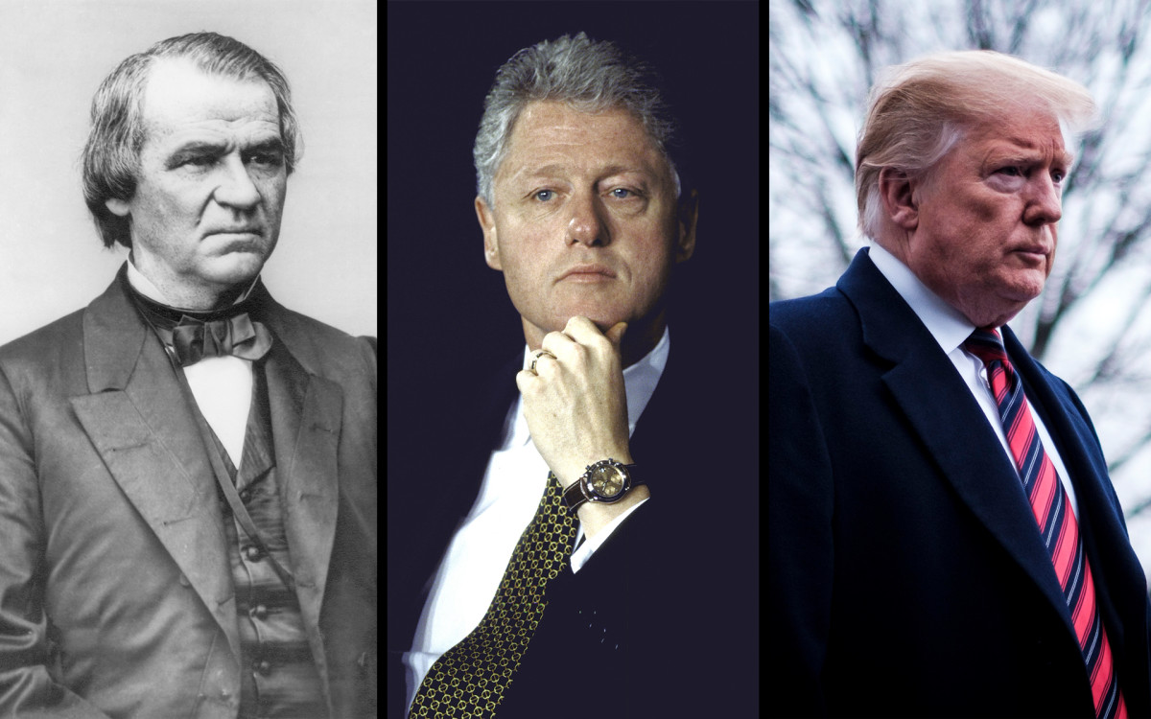
To remove or not remove, that is the question.
3 Presidents impeached in us history
Who are they?
The process of impeachment: https://www.youtube.com/watch?v=HRQrJED-Biw
https://abcnews.go.com/Politics/trumps-impeachment-trial-watch/story?id=68251166
https://www.youtube.com/watch?v=OOXf0nfsd8s
https://www.youtube.com/watch?v=hSszixvo7d8

Slide 3
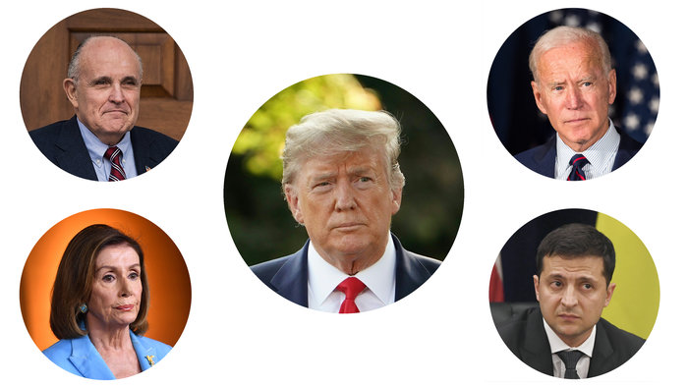
impeachment
Donald trump, 45th president
Accused of:
  Abuse of power
  Obstruction of congress
Phone call to Ukraine’s president in July, 2019 asking him to investigate a political rival, joe biden
Trump used military aid money ($400 million) as a carrot and stick for the ukranian president’s cooperation

Slide 4
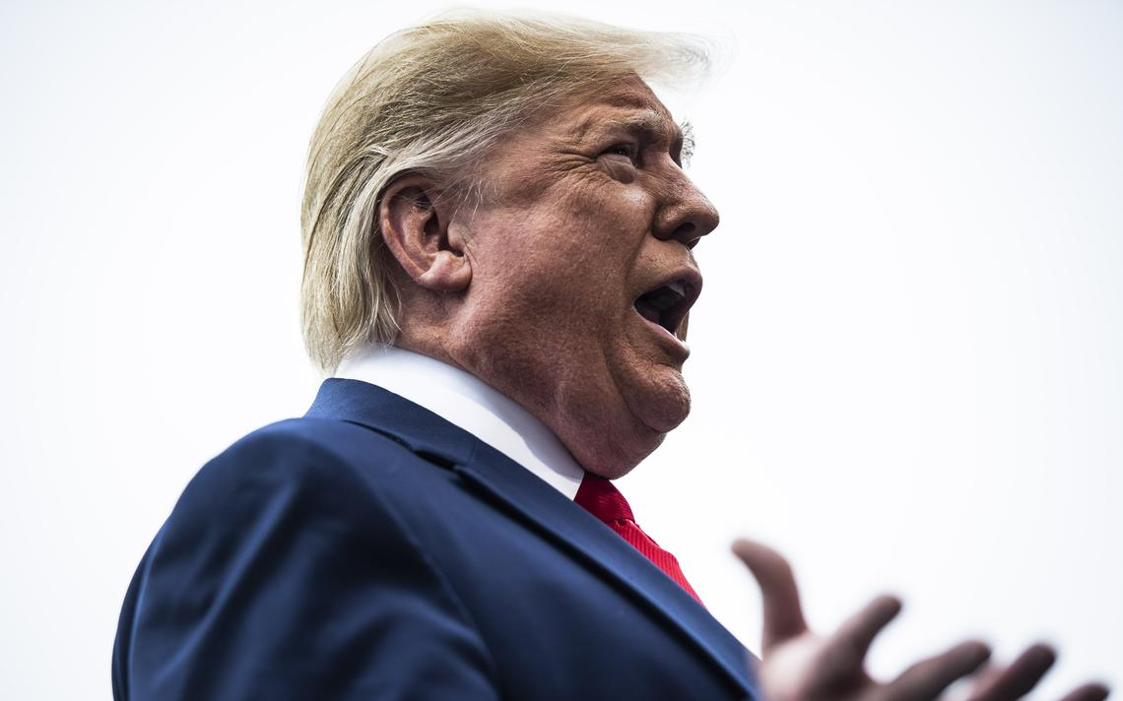
Trump has insisted his efforts were to root out corruption, although Pentagon and State Department officials testified that Ukraine's newly elected government had met the necessary requirements and that helping Ukraine fend off Russian aggression advanced U.S. security interests.

Slide 5
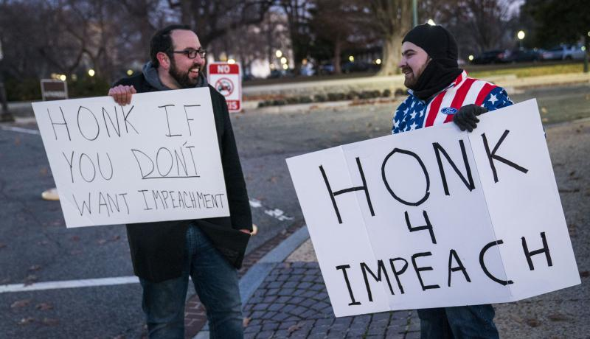
House investigators were ultimately able to document extensive evidence of a pressure campaign orchestrated by Trump's lawyer, Rudy Giuliani, and executed by a former campaign donor -- Gordon Sondland, who was appointed as European ambassador.
But because the White House directed current and former staff members not to comply with subpoenas, the inquiry left unanswered at least one key question: Did Trump tell his aides he'd only release the aid after Ukraine's president agreed to announce an investigation into the Bidens?
Democrats decided against waiting for the courts to weigh in on whether the White House should be forced to comply with subpoenas. On Dec. 18, the House voted 230-197 in favor of the article alleging abuse of power, and 229-198 in favor of the charge of obstruction of Congress.

Slide 6
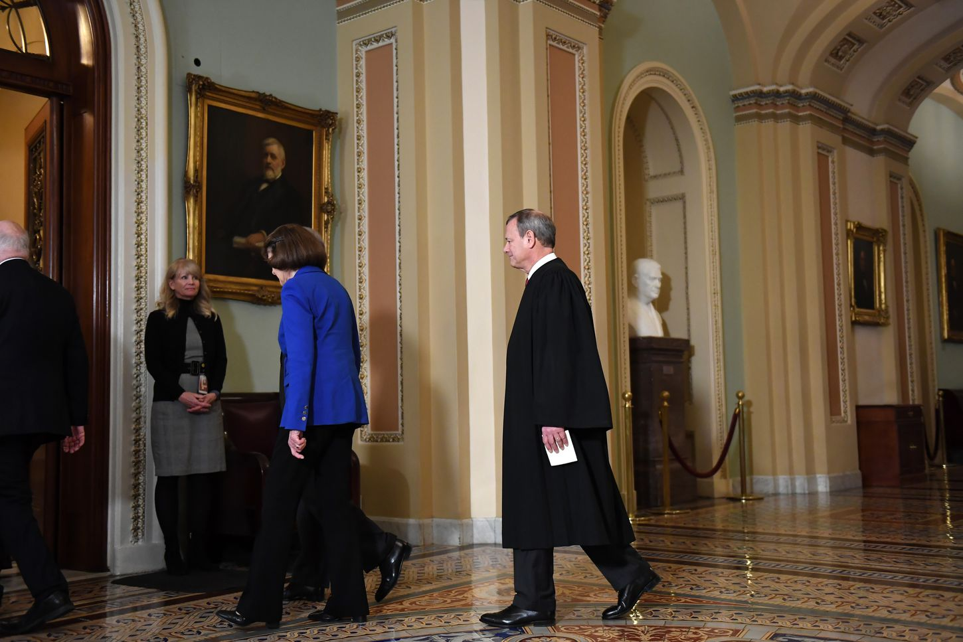
House of representatives controlled by democrats
December hearings and vote of impeachment
The senate serves as jurors and will decide whether to remove trump (not likely)
Chief justice of the supreme court presides over the hearings

Slide 7
https://www.washingtonpost.com/politics/2019/12/18/house-is-voting-impeach-trump-what-happens-next/?arc404=true
Image

Slide 8
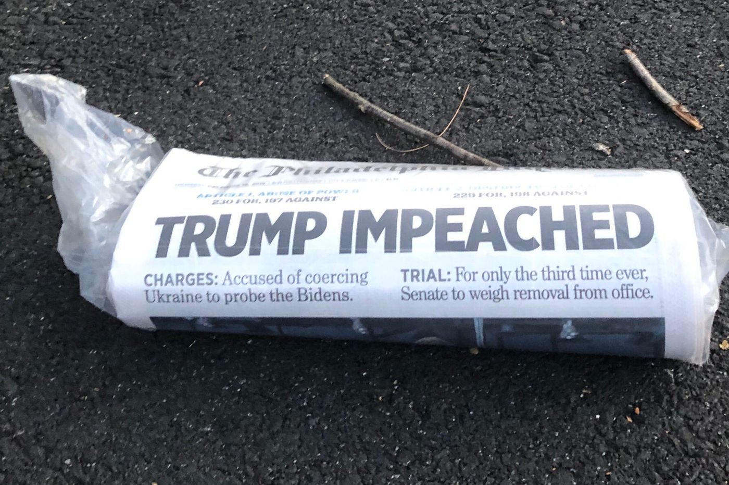
Democrats want the administration to release key documents. Emails, calendars and other items that could shed light on Ukraine policy.
They also want trump aides and former national security advisor, john Bolton to testify.
Republicans want joe and his son hunter biden, along with the whistleblower to testify.

Slide 9
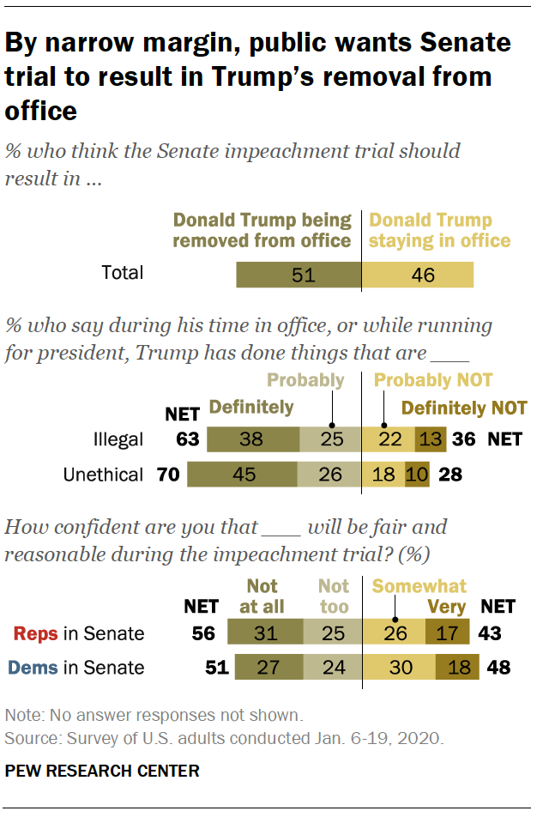
Public opinion

Slide 10
https://www.people-press.org/2020/01/22/by-a-narrow-margin-americans-say-senate-trial-should-result-in-trumps-removal/
More public opinion based on race, gender, and level of education

Slide 11
Sources
https://www.allsides.com/unbiased-balanced-news
National public radio (NPR)
ABC news
The Washington post

Slide 12
sparks
1- Do you think that republicans and democrats should call key witnesses? Why or why not?
2- What impact do you think the impeachment will have on the 2020 presidential election?
3- what are your thoughts on the president’s actions where Ukraine is concerned? Do you think he abused his power? Why or why not?
4- do you think trump should be removed from office? Why or why not?
5- Other thoughts?

Slide 13
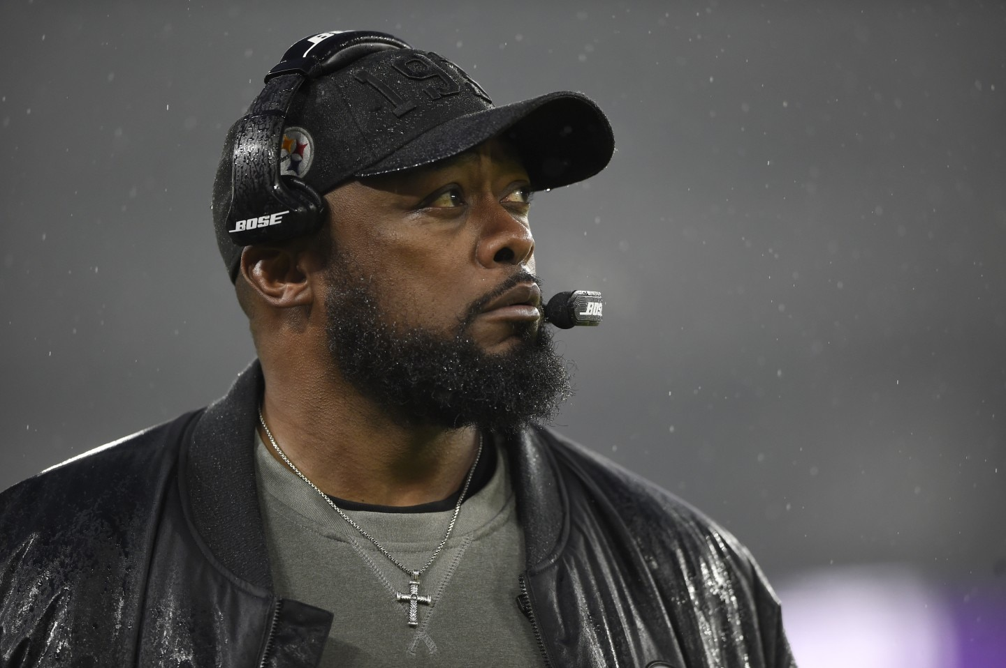
The dearth of black coaches in the NFL is a problem that somehow still hasn’t been fixed
Why is it always about race?
87 years of slavery, the Civil War and another century before the Civil Rights Act with Jim Crow in between, mass incarceration

Slide 14
In the NFL, 70 percent of the players are black, but never have more than 25 percent of the head coaches been black. That number is usually much lower, as it is right now — the Pittsburgh Steelers’ Mike Tomlin, the Los Angeles Chargers’ Anthony Lynn and the Miami Dolphins’ Brian Flores are the only black head coaches among 32 franchises.

Slide 15
In fact, only once in NFL history has a team replaced a black head coach with another black man — in 2009, when the Indianapolis Colts’ Tony Dungy retired and Jim Caldwell succeeded him.

Slide 16
After Barack Obama was elected president in 2008, many thought a post-racial America — in which prejudice fades as black and white become immaterial — had arrived.

Slide 17
1- Do you think the lack of black head coaches in the nfl is a product of
racism? What other factors could be at play?

